Slide 1
Digital Payment Adoption & Retail Sector Growth: State Level UPI Analysis
By Aman Sachin Kujur
BS in Data science & applications (23f3002457)
Indian Institute of Technology, Madras, Chennai

Slide 2
BACKGROUND OF THE PROBLEM
Background
UPI adoption in India has increased rapidly after 2016
Retail sector growth differs significantly across states
Not all high-UPI states show high retail growth
Problem
Does higher digital payment usage actually improve retail sector growth?
Which states show retail growth but low digital payment usage?
Objectives
Measure relationship between UPI transaction intensity and Retail GSVA growth
Identify states with untapped digital payment potential
Classify states based on growth, size, and digital payment usage

Slide 3
Data Sources & Dataset Structure
Data Sources
Retail Sector Output
Source: Ministry of Statistics and Programme Implementation (MoSPI)
Sector: Trade, Repair, Hotels & Restaurants (Retail sector)
Coverage: State-wise
Period: FY 2011-12 to FY 2023-24
Digital Payments
Source: National Payments Corporation of India (NPCI)
National monthly UPI transactions (Volume & Value) — 2016 onwards
State-wise UPI transaction value — FY 2023-24
Key Variables Constructed
Retail GSVA (₹)
Absolute GSVA Increase
GSVA Growth %
UPI Transaction Value
UPI Share (% of national total)
Data Preparation
Monthly UPI aggregated → Financial year totals
State names standardized
States with missing GSVA excluded
Units converted to common monetary scale

Slide 4
Descriptive Statistics
Variable | Mean | Median | Std. Dev | Minimum | Maximum | IQR
Retail GSVA (2023-24) | 5,527,907.90 | 3,172,405 | 5,635,979.82 | 63,337.74 | 17,628,320.70 | 9,071,524.69
GSVA Growth % | 124.27 | 100.56 | 93.15 | -0.04 | 458.41 | 56.72
UPI Transaction Value (2023-24) | 457,993.38 | 182,326.64 | 648,364.55 | 360.02 | 3,168,886.74 | 689,721.99

Slide 5
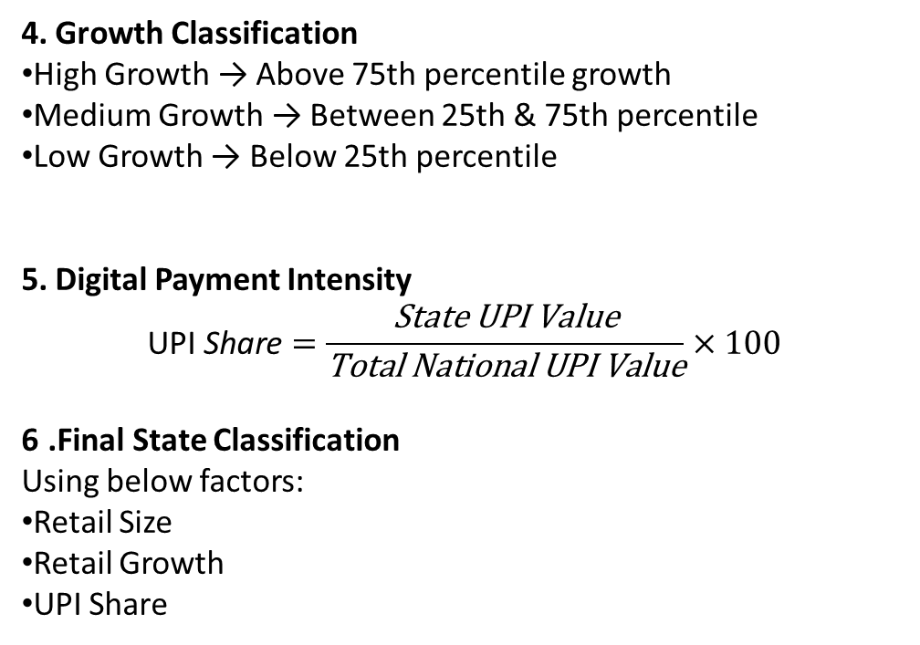
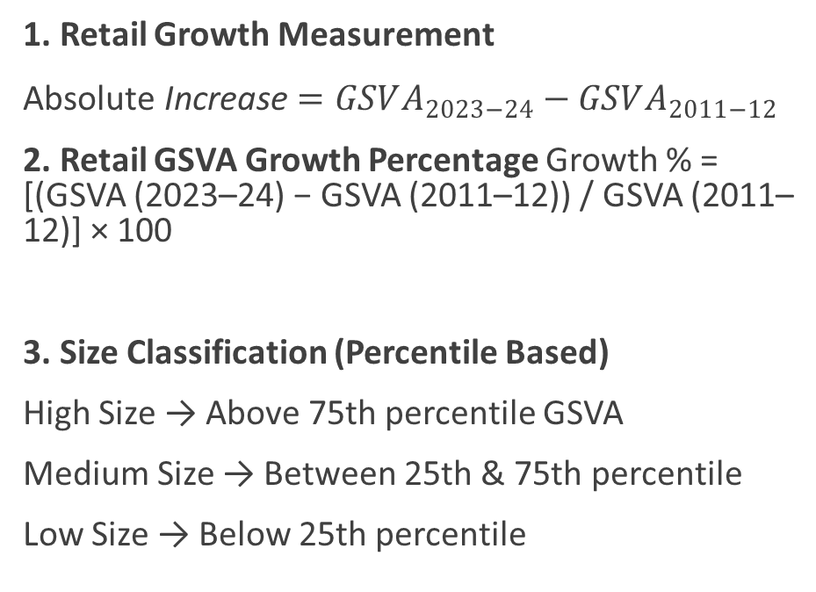
Methodology
1. Retail Growth Measurement
$\text{Absolute} \text{Increase}=GSVA_{2023−24}−GSVA_{2011−12}$
2. Retail GSVA Growth Percentage Growth % = [(GSVA (2023–24) − GSVA (2011–12)) / GSVA (2011–12)] × 100
3. Size Classification (Percentile Based)
High Size → Above 75th percentile GSVA
Medium Size → Between 25th & 75th percentile
Low Size → Below 25th percentile
4. Growth Classification
High Growth → Above 75th percentile growth
Medium Growth → Between 25th & 75th percentile
Low Growth → Below 25th percentile
5. Digital Payment Intensity
$$\text{UPI} \text{Share}=\frac{\text{State} \text{UPI} \text{Value}}{\text{Total} \text{National} \text{UPI} \text{Value}}×100$$
6 .Final State Classification
Using below factors:
Retail Size
Retail Growth
UPI Share

Slide 6
Retail GSVA Trends Across States

Slide 7
UPI Growth Trend

Slide 8
State-wise Digital Payment Distribution

Slide 9
Relationship Between UPI & Retail Growth
3. Emerging Growth Markets
States showing strong retail growth but relatively low digital payment usage Examples: Jharkhand, Tripura, Meghalaya, Uttarakhand
4. Low Adoption & Low Maturity States
Smaller retail markets with low growth and limited digital payment penetration Examples: Goa, Nagaland, Puducherry, Manipur
1. Core Growth Engines
Large retail markets with strong growth and high digital payment usage Examples: Telangana, Gujarat
2. Digitally Mature Markets
Large retail markets where digital payments are already widely adopted but growth is moderate Examples: Maharashtra, Tamil Nadu, Karnataka, Uttar Pradesh

Slide 10
Conclusion & Recommendations
Conclusion
Retail GSVA growth exists across states both before and after UPI adoption
UPI usage is concentrated in economically larger states
No consistent relationship between UPI transaction share and retail growth
Digital payments improve efficiency and formalization, not primary growth driver
Recommendations
For Emerging Growth States
Promote merchant onboarding and QR acceptance
Digital payment awareness for small retailers
For Low Adoption States
Improve digital infrastructure and connectivity first
Gradual payment adoption instead of aggressive rollout
For Mature Markets
Focus on value-added digital services (credit, analytics, loyalty)

